Slide 1
CSCI 631 Foundations of Computer Vision
Ifeoma Nwogu
ion@cs.rit.edu
Lecture -Recurrent Neural Networks (RNN)

Slide 2
Schedule
Last class
CNN
Today
Recurrent neural networks (RNN)
Slides curtsey of Svetlana Lazebnik and Arun Mallya

Slide 3
Motivation for RNN
Not all problems can be converted into one with fixed-length inputs and outputs
Problems such as Speech Recognition or Time-series Prediction require a system to store and use context information
Simple case: Output YES if the number of 1s is even, else NO 1000010101 – YES, 100011 – NO, …
Hard/Impossible to choose a fixed context window
There can always be a new sample longer than anything seen

Slide 4
The parity problem
Data transmission in communication systems
A source sends a bitstream to a receiver
How can we detect if one bit is reversed?
Add a parity bit to the end of each stream
Agree that streams have even number of ones
If #1s in stream is odd, add a parity bit 1 to make total even
If #1s in stream is even, add a parity bit 0 to leave total even
When stream is received if total number of bits is odd, there is an error

Slide 5
More on RNN motivation
Fill in the blanks:
I just took a _______
I’m tired; I just took a _____
Finals were today; I’m tired; I just took a _____

Slide 6
Motivation continued
RNNs take in a large corpus of text or other sequences and analyzes the sequences for context
Context info gets better as sequences get larger.
RNNs analyze sequences to make predictions about them and infer context from them.

Slide 7
Why not CNN?
RNNs have memory - they are suited to problems when we incorporate previous predictions to make new prediction.
E.g. with sequential signals such as audio, video, text.

Slide 8
Recurrent Neural Networks (RNNs)
Recurrent Neural Networks take the previous output or hidden states as inputs. The composite input at time t has some historical information about the happenings at time T < t
RNNs are useful as their intermediate values (state) can store information about past inputs for a time that is not fixed a priori

Slide 9
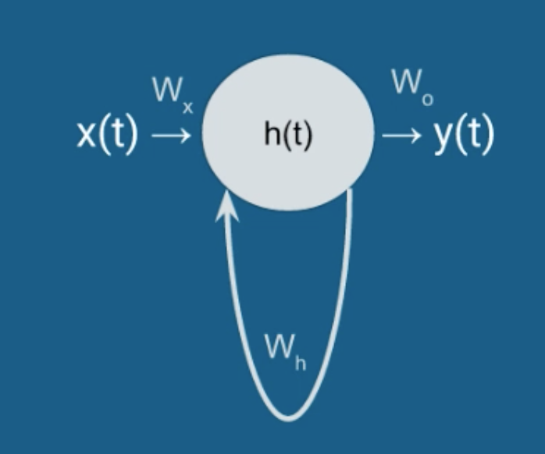
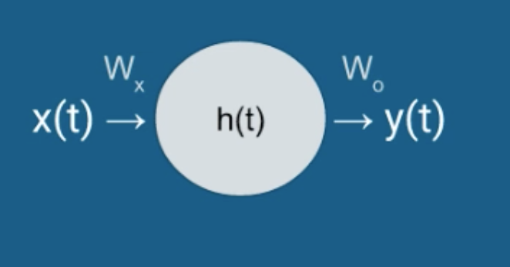
Simple recurrent unit
Basic feed forward network
Recurrent network

Slide 10
Simple recurrent unit
What is the size of W_{h}?
Like previous networks, across layers, everything connects to everything
One node in h(t) connects back to all nodes (from previous time step)
If h(t) has M nodes, then W_{h} is an M-by-M matrix

Slide 11
Simple recurrent unit
What is the size of W_{h}?
h(t) = f(W_{h}^{T}h(t-1) + W_{x}^{T}x(t) + b_{h})
y(t) = softmax(W_{o}^{T}h(t) + b_{o})
f = tanh, sigmoid or ReLU

Slide 12
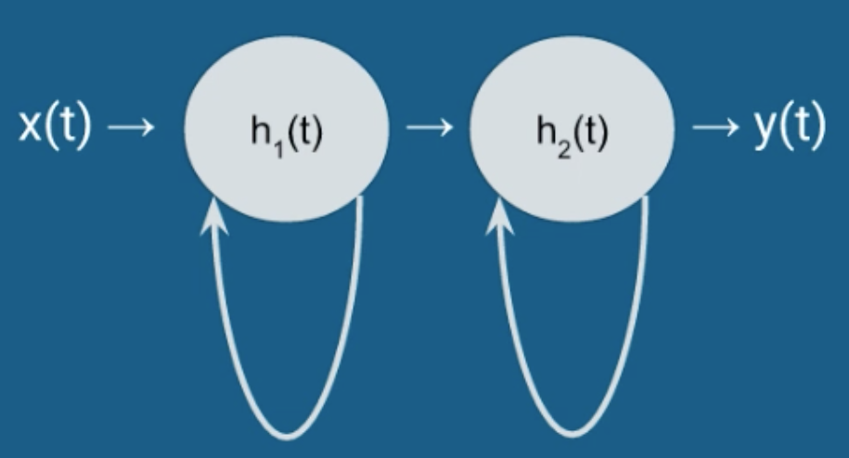
RNN with multiple hidden layers

Slide 13
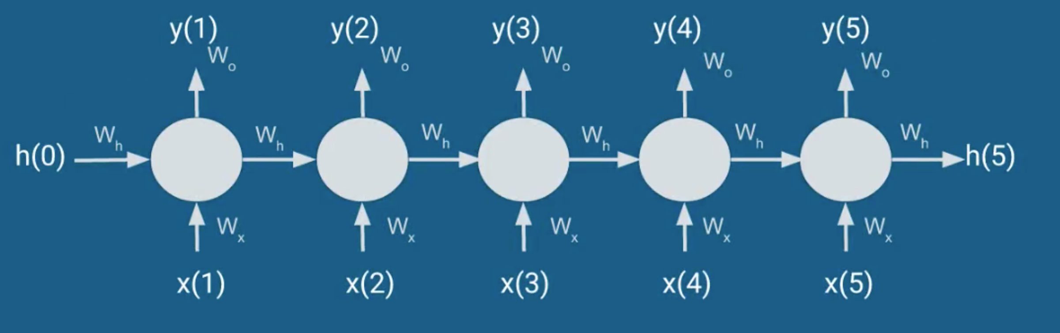
The unfolded RNN

Slide 14
RNN uses
Predict an entire sequence (class labels)
Male versus female gait
Predict a class label for every time step
Continuous emotion monitoring (election debates)
Predict the next value (no labels)
Image/caption generations from video sequences

Slide 15
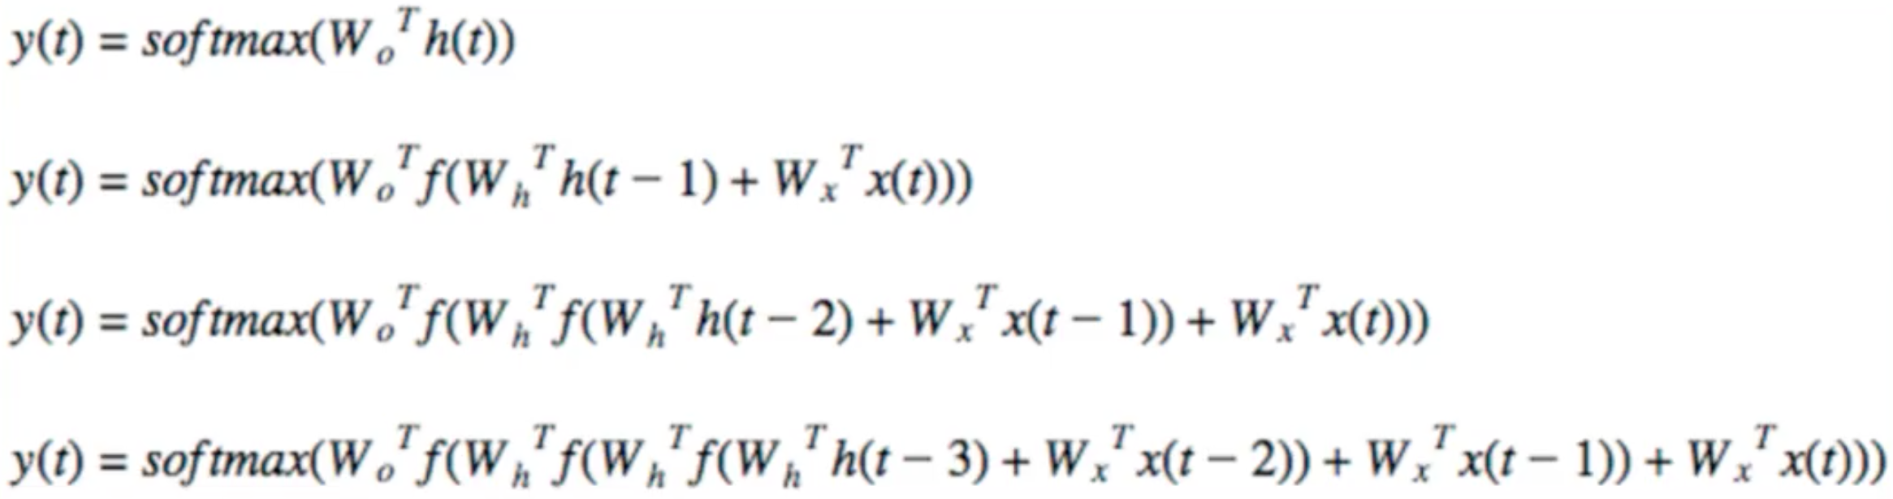
Backpropagating an RNN
Backpropagation is just a fancy name for gradient descent!

Slide 16
2 Key Ideas
Parameter Sharing
in computation graphs = adding gradients
“Unrolling”
in computation graphs with parameter sharing
Parameter sharing + Unrolling
Allows modeling arbitrary sequence lengths!
Keeps numbers of parameters in check

Slide 17
Recurrent Neural Network
RNN
x
Slide Credit: Fei-Fei Li, Justin Johnson, Serena Yeung, CS 231n

Slide 18
Recurrent Neural Network
y
usually want to predict a vector at some time steps
RNN
x
Slide Credit: Fei-Fei Li, Justin Johnson, Serena Yeung, CS 231n

Slide 19
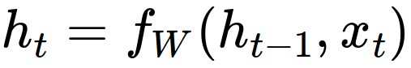
Recurrent Neural Network
We can process a sequence of vectors x by applying a recurrence formula at every time step:
y
RNN
new state
old state
input vector at some time step
some function
with parameters W
x
Slide Credit: Fei-Fei Li, Justin Johnson, Serena Yeung, CS 231n

Slide 20
Recurrent Neural Network
We can process a sequence of vectors x by applying a recurrence formula at every time step:
y
RNN
Notice: the same function and the same set of parameters are used at every time step.
x
Slide Credit: Fei-Fei Li, Justin Johnson, Serena Yeung, CS 231n

Slide 21
(Vanilla) Recurrent Neural Network
The state consists of a single “hidden” vector h:
y
RNN
x
Slide Credit: Fei-Fei Li, Justin Johnson, Serena Yeung, CS 231n

Slide 22
RNN: Computational Graph
h₀
f_{W}
h₁
x₁
Slide Credit: Fei-Fei Li, Justin Johnson, Serena Yeung, CS 231n

Slide 23
RNN: Computational Graph
h₀
f_{W}
h₁
f_{W}
h₂
x₁
x₂
Slide Credit: Fei-Fei Li, Justin Johnson, Serena Yeung, CS 231n

Slide 24
RNN: Computational Graph
h₀
h₁
h₂
h₃
…
h_{T}
f_{W}
f_{W}
f_{W}
x₁
x₂
x₃
Slide Credit: Fei-Fei Li, Justin Johnson, Serena Yeung, CS 231n

Slide 25
RNN: Computational Graph
Re-use the same weight matrix at every time-step
h₀
h₁
h₂
h₃
…
h_{T}
f_{W}
f_{W}
f_{W}
x₁
x₂
x₃
W
Slide Credit: Fei-Fei Li, Justin Johnson, Serena Yeung, CS 231n

Slide 26
RNN: Computational Graph: Many to Many
y₁
y₂
y₃
y_{T}
h₀
h₁
h₂
h₃
…
h_{T}
f_{W}
f_{W}
f_{W}
x₁
x₂
x₃
W
Slide Credit: Fei-Fei Li, Justin Johnson, Serena Yeung, CS 231n

Slide 27
RNN: Computational Graph: Many to Many
y₁
y₂
y₃
y_{T}
L₁
L₂
L₃
L_{T}
h₀
h₁
h₂
h₃
…
h_{T}
f_{W}
f_{W}
f_{W}
x₁
x₂
x₃
W
Slide Credit: Fei-Fei Li, Justin Johnson, Serena Yeung, CS 231n

Slide 28
L
RNN: Computational Graph: Many to Many
y₁
y₂
y₃
y_{T}
L₁
L₂
L₃
L_{T}
h₀
h₁
h₂
h₃
…
h_{T}
f_{W}
f_{W}
f_{W}
x₁
x₂
x₃
W
Slide Credit: Fei-Fei Li, Justin Johnson, Serena Yeung, CS 231n

Slide 29
RNN: Computational Graph: Many to One
y
h₀
h₁
h₂
h₃
…
h_{T}
f_{W}
f_{W}
f_{W}
x₁
x₂
x₃
W
Slide Credit: Fei-Fei Li, Justin Johnson, Serena Yeung, CS 231n

Slide 30
RNN: Computational Graph: One to Many
y₁
y₂
y₃
y_{T}
h₀
h₁
h₂
h₃
…
h_{T}
f_{W}
f_{W}
f_{W}
x
W
Slide Credit: Fei-Fei Li, Justin Johnson, Serena Yeung, CS 231n

Slide 31
Sequence to Sequence: Many-to-one + one-to-many
Many to one: Encode input sequence in a single vector
h₀
f_{W}
h₁
f_{W}
h₂
f_{W}
h₃
…
h_{T}
x₁
x₂
x₃
W₁
Slide Credit: Fei-Fei Li, Justin Johnson, Serena Yeung, CS 231n

Slide 32
Sequence to Sequence: Many-to-one + one-to-many
One to many: Produce output sequence from single input vector
Many to one: Encode input sequence in a single vector
y₁
y₂
h₀
f_{W}
h₁
f_{W}
h₂
f_{W}
h₃
…
h_{T}
h₁
h₂
…
f_{W}
f_{W}
f_{W}
x₁
x₂
x₃
W₁
W₂
Slide Credit: Fei-Fei Li, Justin Johnson, Serena Yeung, CS 231n

Slide 33
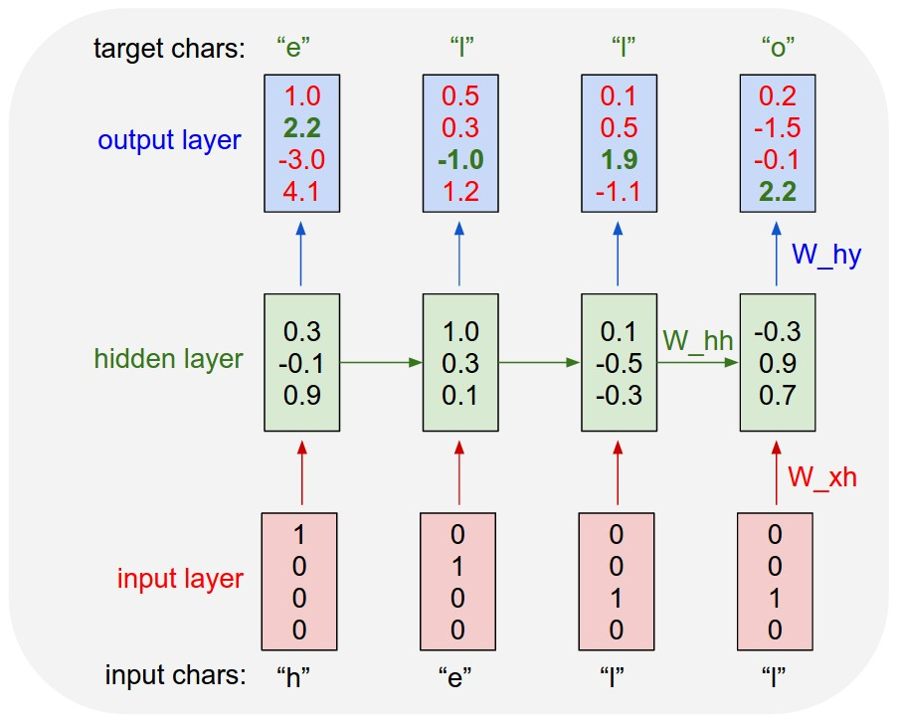
Example: Character-level
Language Model
Vocabulary:
[h,e,l,o]
Example training
sequence:
“hello”
Slide Credit: Fei-Fei Li, Justin Johnson, Serena Yeung, CS 231n

Slide 34
Example: Character-level
Language Model
Vocabulary:
[h,e,l,o]
Example training
sequence:
“hello”
Slide Credit: Fei-Fei Li, Justin Johnson, Serena Yeung, CS 231n

Slide 35
Example: Character-level
Language Model
Vocabulary:
[h,e,l,o]
Example training
sequence:
“hello”
Slide Credit: Fei-Fei Li, Justin Johnson, Serena Yeung, CS 231n

Slide 36
Example: Character-level
Language Model
Sampling
Vocabulary:
[h,e,l,o]
At test-time sample characters one at a time, feed back to model
“e”
“l”
“l”
“o”
Sample
.03
.13
.00
.84
.25
.20
.05
.50
.11
.17
.68
.03
.11
.02.08
.79
Softmax
Slide Credit: Fei-Fei Li, Justin Johnson, Serena Yeung, CS 231n

Slide 37
Example: Character-level
Language Model
Sampling
Vocabulary:
[h,e,l,o]
At test-time sample characters one at a time, feed back to model
“e”
“l”
“l”
“o”
Sample
.03
.13
.00
.84
.25
.20
.05
.50
.11
.17
.68
.03
.11
.02.08
.79
Softmax
Slide Credit: Fei-Fei Li, Justin Johnson, Serena Yeung, CS 231n

Slide 38
Example: Character-level
Language Model
Sampling
Vocabulary:
[h,e,l,o]
At test-time sample characters one at a time, feed back to model
“e”
“l”
“l”
“o”
Sample
.03
.13
.00
.84
.25
.20
.05
.50
.11
.17
.68
.03
.11
.02.08
.79
Softmax
Slide Credit: Fei-Fei Li, Justin Johnson, Serena Yeung, CS 231n

Slide 39
Example: Character-level
Language Model
Sampling
Vocabulary:
[h,e,l,o]
At test-time sample characters one at a time, feed back to model
“e”
“l”
“l”
“o”
Sample
.03
.13
.00
.84
.25
.20
.05
.50
.11
.17
.68
.03
.11
.02.08
.79
Softmax
Slide Credit: Fei-Fei Li, Justin Johnson, Serena Yeung, CS 231n

Slide 40
Basic Feed-forward Network
y₁
h₁
x₁
t = 1

Slide 41
Basic RNN
y₃
y₂
h₃
y₁
h₂
x₃
h₁
t = 3
x₂
x₁
t = 2
t = 1

Slide 42
Basic RNN
y₃
y₂
h₃
y₁
h₂
x₃
h₁
t = 3
x₂
h₀
t = 2
x₁
t = 1

Slide 43
Sentiment Classification
Classify a restaurant review from Yelp! OR movie review from IMDB OR … as positive or negative
Inputs: Multiple words, one or more sentences
Outputs: Positive / Negative classification
“The food was really good”
“The chicken crossed the road because it was uncooked”

Slide 44
Sentiment Classification
RNN
h₁
The

Slide 45
Sentiment Classification
RNN
RNN
h₁
h₂
The
food

Slide 46
Sentiment Classification
h_{n}
RNN
RNN
RNN
h₁
h₂
h_{n-1}
The
food
good

Slide 47


Sentiment Classification
Linear Classifier
h_{n}
RNN
RNN
RNN
h₁
h₂
h_{n-1}
The
food
good

Slide 48
Sentiment Classification
Ignore
Ignore
Linear Classifier
h₁
h₂
h_{n}
RNN
RNN
RNN
h₁
h₂
h_{n-1}
The
food
good

Slide 49
Sentiment Classification
h = Sum(…)
h₁
h_{n}
h₂
RNN
RNN
RNN
h₁
h₂
h_{n-1}
The
food
good
http://deeplearning.net/tutorial/lstm.html

Slide 50
Sentiment Classification
Linear Classifier
h = Sum(…)
h₁
h_{n}
h₂
RNN
RNN
RNN
h₁
h₂
h_{n-1}
The
food
good
http://deeplearning.net/tutorial/lstm.html

Slide 51
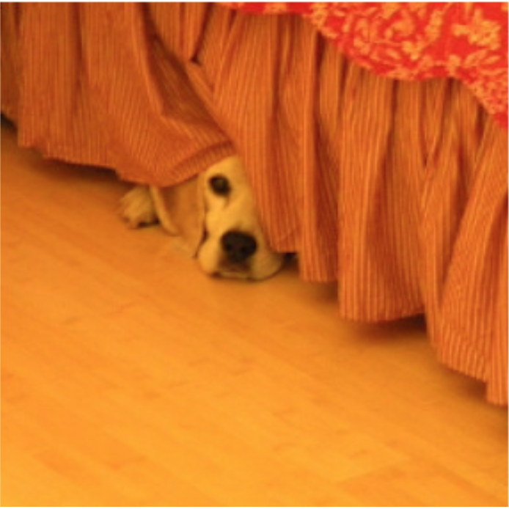
Image Captioning
Given an image, produce a sentence describing its contents
Inputs: Image feature (from a CNN)
Outputs: Multiple words (let’s consider one sentence)
: The dog is hiding

Slide 52
Image Captioning
RNN
CNN

Slide 53
Image Captioning
The
Linear Classifier
h₂
RNN
RNN
h₁
h₂
CNN

Slide 54
Image Captioning
The
dog
Linear Classifier
Linear Classifier
h₂
h₃
RNN
RNN
RNN
h₁
h₂
h₃
CNN

Slide 55
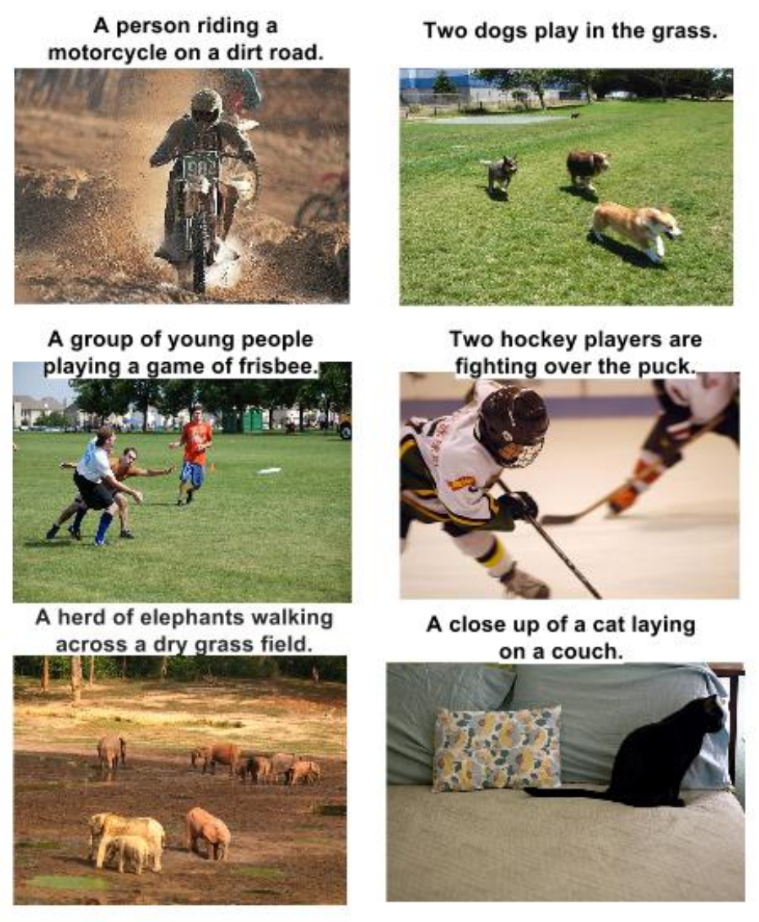
RNN Outputs: Image Captions
Show and Tell: A Neural Image Caption Generator, CVPR 15

Slide 56
RNN Outputs: Language Modeling
VIOLA:
Why, Salisbury must find his flesh and thought
That which I am not aps, not a man and in fire,
To show the reining of the raven and the wars
To grace my hand reproach within, and not a fair are hand,
That Caesar and my goodly father's world;
When I was heaven of presence and our fleets,
We spare with hours, but cut thy council I am great,
Murdered and by thy master's ready there
My power to give thee but so much as hell:
Some service in the noble bondman here,
Would show him to her wine.
KING LEAR:
O, if you were a feeble sight, the courtesy of your law,
Your sight and several breath, will wear the gods
With his heads, and my hands are wonder'd at the deeds,
So drop upon your lordship's head, and your opinion
Shall be against your honour.
http://karpathy.github.io/2015/05/21/rnn-effectiveness/

Slide 57
Input – Output Scenarios
Single - Single
Feed-forward Network
Single - Multiple
Image Captioning
Multiple - Single
Sentiment Classification
Multiple - Multiple
Translation
Image/Video Captioning

Slide 58
Input – Output Scenarios
Note: We might deliberately choose to frame our problem as a particular input-output scenario for ease of training or better performance.
For example, at each time step, provide previous word as input for image captioning (Single-Multiple to Multiple-Multiple)

Slide 59
The Vanilla RNN Forward
C₁
C₂
C₃
y₁
y₂
y₃
x₁ h₀
x₂ h₁
h₁
x₃ h₂
h₂
“Unfold” network through time by making copies at each time-step
h₃

Slide 60
BackPropagation Refresher
C
y
f(x; W)
x

Slide 61
Multiple Layers
C
y₂
f₂(y₁; W₂)
y₁
f₁(x; W₁)
x

Slide 62
Chain Rule for Gradient Computation
C
y₂
f₂(y₁; W₂)
y₁
f₁(x; W₁)
x
Application of the Chain Rule

Slide 63
Chain Rule for Gradient Computation
Given:
We are interested in computing:
y
Intrinsic to the layer are:
f(x; W)
x

Slide 64
Chain Rule for Gradient Computation
Given:
We are interested in computing:
Intrinsic to the layer are:
f(x; W)

Slide 65
Extension to Computational Graphs
y₁
y₂
y
f₁(y; W₁)
f₂(y; W₂)
f(x; W)
y
y
x
f(x; W)
x

Slide 66
Extension to Computational Graphs
f₁(y; W₁)
f₂(y; W₂)
f(x; W)
f(x; W)

Slide 67
Extension to Computational Graphs
f₁(y; W₁)
f₂(y; W₂)
f(x; W)
Gradient Accumulation
f(x; W)

Slide 68
BackPropagation Through Time (BPTT)
One of the methods used to train RNNs
The unfolded network (used during forward pass) is treated as one big feed-forward network
This unfolded network accepts the whole time series as input
The weight updates are computed for each copy in the unfolded network, then summed (or averaged) and then applied to the RNN weights

Slide 69
The Unfolded Vanilla RNN
C₁
C₂
C₃
y₁
y₂
y₃
Treat the unfolded network as one big feed-forward network!
This big network takes in entire sequence as an input
Compute gradients through the usual backpropagation
Update shared weights
h₁
h₃
h₂
h₂
h₁
h₀
x₁
x₂
x₃

Slide 70
The Unfolded Vanilla RNN Forward
C₁
C₂
C₃
y₁
y₂
y₃
x₁ h₀
x₂ h₁
h₁
x₃ h₂
h₂
h₃

Slide 71
The Unfolded Vanilla RNN Backward
C₁
C₂
C₃
y₁
y₂
y₃
x₁ h₀
x₂ h₁
h₁
x₃ h₂
h₂
h₃
Notes:
refresher for backprop before this

Slide 72
The Vanilla RNN Backward
C₁
C₂
C₃
y₁
y₂
y₃
x₁ h₀
x₂ h₁
h₁
x₃ h₂
h₂
h₃
Notes:
refresher for backprop before this

Slide 73
Issues with the Vanilla RNNs
In the same way a product of k real numbers can shrink to zero or explode to infinity, so can a product of matrices
It is sufficient for , where is the largest singular value of W, for the vanishing gradients problem to occur and it is necessary for exploding gradients that , where for the tanh non-linearity and for the sigmoid non-linearity ¹
Exploding gradients are often controlled with gradient element-wise or norm clipping
¹ On the difficulty of training recurrent neural networks, Pascanu et al., 2013

Slide 74
Long Short-Term Memory (LSTM)¹
The LSTM uses this idea of “Constant Error Flow” for RNNs to create a “Constant Error Carousel” (CEC) which ensures that gradients don’t decay
The key component is a memory cell that acts like an accumulator (contains the identity relationship) over time
Instead of computing new state as a matrix product with the old state, it rather computes the difference between them. Expressivity is the same, but gradients are better behaved
¹ Long Short-Term Memory, Hochreiter et al., 1997

Slide 75
The LSTM Idea
x_{t}
h_{t-1}
W
Cell
c_{t}
h_{t}
* Dashed line indicates time-lag

Slide 76
The Original LSTM Cell
x_{t} h_{t-1}
x_{t} h_{t-1}
W_{i}
W_{o}
Input Gate
i_{t}
Output Gate
o_{t}
x_{t}
h_{t-1}
W
Cell
c_{t}
h_{t}
Similarly for o_{t}

Slide 77
The Popular LSTM Cell
x_{t} h_{t-1}
x_{t} h_{t-1}
W_{i}
W_{o}
Input Gate
i_{t}
Output Gate
o_{t}
x_{t}
h_{t-1}
W
Cell
c_{t}
h_{t}
f_{t}
Forget Gate
W_{f}
x_{t} h_{t-1}

Slide 78
Summary
RNNs allow for processing of variable length inputs and outputs by maintaining state information across time steps
Various Input-Output scenarios are possible (Single/Multiple)
Vanilla RNNs are improved upon by LSTMs which address the vanishing gradient problem. Exploding gradients are handled by gradient clipping
More complex architectures exist, but there are the building blocks to understanding them well.

Slide 79
Other Useful Resources / References
http://cs231n.stanford.edu/slides/winter1516_lecture10.pdf
http://www.cs.toronto.edu/~rgrosse/csc321/lec10.pdf
R. Pascanu, T. Mikolov, and Y. Bengio, On the difficulty of training recurrent neural networks, ICML 2013
S. Hochreiter, and J. Schmidhuber, Long short-term memory, Neural computation, 1997 9(8), pp.1735-1780
F.A. Gers, and J. Schmidhuber, Recurrent nets that time and count, IJCNN 2000
K. Greff , R.K. Srivastava, J. Koutník, B.R. Steunebrink, and J. Schmidhuber, LSTM: A search space odyssey, IEEE transactions on neural networks and learning systems, 2016
K. Cho, B. Van Merrienboer, C. Gulcehre, D. Bahdanau, F. Bougares, H. Schwenk, and Y. Bengio, Learning phrase representations using RNN encoder-decoder for statistical machine translation, ACL 2014
R. Jozefowicz, W. Zaremba, and I. Sutskever, An empirical exploration of recurrent network architectures, JMLR 2015

Slide 80

Questions

